Slide 1
Fiscal Officers Training
Presented by:
Campus Services

Slide 2
Overview
Responsibilities
KFS Workflow
Balances
Policy and Procedures
Internal Controls

Slide 3
Responsibilities

Slide 4
Fiscal Responsibility
Fiscal responsibility stems from laws, regulations and policies, and is the responsibility of every employee .
The fundamentals of fiscal responsibility call for each employee to make a personal commitment to “do the right thing” and to make decisions that are just and right for the University’s common good.

Slide 5
Stewardship Responsibilities
CSU has a stewardship obligation to:
Properly and accurately process all receipts and disbursement of funds
Account for all financial resources received and used
Ensure that all financial transactions conform to legal requirements and administrative policies, and are recorded in accordance with generally accepted accounting principles for colleges and universities
Provide financial reports that present to all university clients, constituents, and the public a complete picture of the university’s funds and their uses
Timely processing and approving of all financial transactions

Slide 6
Fiscal Officer (FO)
A role assigned in Kuali at the account level
Individual, not group
Can be delegated
Journal Entries entered in Kuali that relate to the account, route to FO for approval
FO must be knowledgeable on the transactions that should hit the account
Funds are spent according to a pre-established budget or need an allocation of expenses are appropriate

Slide 7
Fiscal Officers Responsibilities
Review every Kuali document that routes and if appropriate, approve
A few documents are uploads and do not route (e.g. payroll)
During review must ensure:
Adequate resources exist (i.e. budget or cash)
Entry is correct and is supported by adequate back-up
Accurate
Correct object code/Account Number
Does not violate fiscal rules, Federal or State Laws or Uniform Guidance

Slide 8
Fiscal Officers Responsibilities
Able to answer all questions relating to the account and transactions
Ensure adequate coverage is in place during absence (e.g. fiscal officer delegate in place)

Slide 9
Fiscal Officer Responsibilities
Account Reconciliation
Recommend monthly reconciliation, but at a minimum quarterly reconciliation of the account to ensure:
Appropriate charges - charges are appropriate and charged to correct account
Not overspent - account is not in cash deficit or exceeds budget
Expense being recorded in period incurred and revenue being recorded in period earned
No set reconciliation template

Slide 10
Reconciliation Example-Salary Savings
Notes:
This example shows how we calculate salary savings during an open position. Employee 3 left in November, and replacement (Employee 7) didn’t start till end of January.

Slide 11
Reconciliation Example-Error
Notes:
This report shows summary by object code, but how if you dig deeper you can see missed billings. For example, Voicemail is $3/person, but this department has 6 people so it should be $18/month and not $15/month. Based on this, and discussions with the phone service, it was noted the charge was hitting a different account and needed to be corrected.

Slide 12
Reconciliation- Example - Reimbursement
Notes:
This is an example of a Foundation account, and a reconciliation to ensure funds are being received. However, this summary page, due to timing of revenue (received after expenses incurred) does not give all the information I need. So the next slide shows more detail to arrive at if all is caught up.

Slide 13
Reconciliation- Example - Reimbursement
Notes:
This is a transaction level detail of revenue and expenses. It totals the July expenses and shows the revenue fully offsets this expense, as does September. However, October and November haven’t been reimbursed. I know that October has been billed, but not yet received, but November has not been billed.

Slide 14
Reconciliation Example - Comparative
Notes:
This reconciliation shows the balance sheet and income statement. It compares each quarter to see how it is doing, to make sure it is staying positive. It also includes explanations on those balances.

Slide 15
Kuali Workflow-Fiscal Officer
Approves all Adjustment/Accrual Vouchers, Budget Adjustments, Distribution of Income and Expense, General Error Correction, Encumbrance and Transfer of Funds
$1,000 or greater approves: Disbursement Voucher, Internal Billing, Internal Order, Requisition
Does not approve: automatic uploads such as payroll and student/commercial receivables
Fiscal Officer Route Log Example:

Slide 16
Account Supervisor
Normally dean, department head, business manager, or other senior administrator
No approval role in Kuali
Provides leadership role by providing oversight for account management
Cannot be the Fiscal Officer or Account Manager

Slide 17
Organizational Approver
ORG-XXXX
Multiple people in group, but only needs 1 to approve
Access is granted via a form, and not through edit in Kuali
Approver is normally a business manager, department manager, or other senior administrator

Slide 18
Organization approval
ORG-xxxx
Approves all Adjustment/Accrual Vouchers, Budget Adjustments, Distribution of Income and Expense, General Error Correction, Encumbrance and Transfer of Funds
$1,000 or greater: Disbursement Voucher, Internal Billing, Internal Order, Requisition
Organization Approval Route Log Example:

Slide 19
Division Approver
DIV-xx
Multiple people in group, but only needs one to approve
Access is granted via a form, and not through edit in Kuali
Typically dean, department head, or other senior administrator
For small department, individual can be in ORG and DIV roles, but should not be the fiscal officer

Slide 20
Division Approver
Approves all transactions over $10,000
If you click on DIV-B2, it will show all the individuals listed under that Division
Division Approval Route Log Example:

Slide 21
Balance lookup

Slide 22
Object Codes
Four digit code which specifies the type of activity being charged (assets, liabilities, revenue, expense)

Slide 23
Object Code smart coding
Object Code | Type | Normal Balance | Objects commonly used
1XXX | Asset | Debit | Cash (1100)
2XXX | Liability | Credit | A/P Liability (2100)
3xxx | Beginning Balance | Credit | 3000 Beginning Balance Upload
4XXX 9900 9904 | Revenue | Credit | External Revenue (43xx-44xx) Internal Revenue (48xx-49xx) Transfer Income (9900, 9904-Plant)
5XXX – 6XXX 7xxx-8xxx 9902, 9905 | Expense | Debit | Salary (5xxx), General Supplies (62xx), General Services (66xx) COGS, Equipment (7xxx-8xxx), Transfer Expense (9902, 9905-Plant)

Slide 24
Budget vs Self Funded (Cash)
Budget Based: calculate based off of budget (e.g. Education and General funds)
Budget – Actual - Encumbrances
Self-Funded (Cash) Based: calculated based off of fund balance (e.g. Athletics, Auxiliaries)
Assets (1xxx) – Liabilities (2xxx)
Capital accounts vary between budget and self-funded

Slide 25
Budget or Self-Funded (Cash)?
Click on account number:

Slide 26
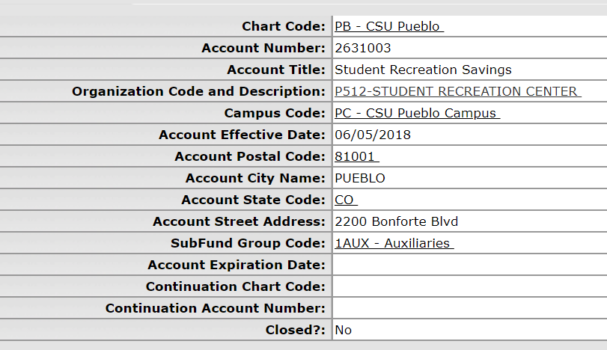
Budget or Self-Funded (Cash)?
Click on SubFund Group Code:

Slide 27
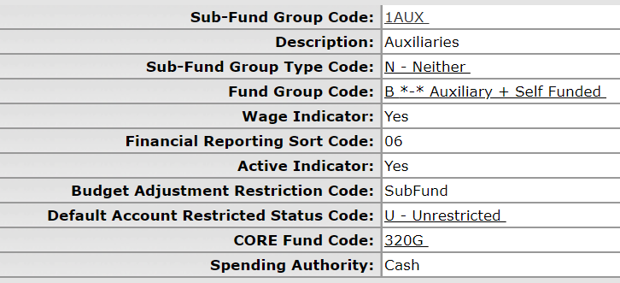
Budget or Self-Funded (Cash)?
Spending Authority will say Cash or Budget:

Slide 28
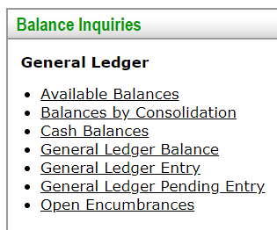
Balance Inquiry
Budget Based: Use Balances by Consolidation
Self-Funded (Cash) Based: Use Available Balances

Slide 29
Balances by Consolidation

Slide 30
Balances by Consolidation

Slide 31
Available Balances

Slide 32
Available Balances
Fund Balance = $40

Slide 33
Policy and Procedures

Slide 34
Policy and Procedures
The CSU System is governed by the CSU System Rules, which then delegates to the campuses, more authority to add more detail/information to the rules
Financial Related Procedures are located: http://busfin.colostate.edu/Resources/Fin_Rules_Procs.aspx
CSU Financial Rules: overview of the Financial Rules that govern CSU-Fort Collins
Financial Procedure Instructions (FPI): goes into further detail regarding the Financial Rules

Slide 36
Financial Procedure instructions (FPI)
Accounting:

Slide 37
Financial Procedure instructions (FPI)
Expenditures and Revenues:

Slide 38
Financial Procedure instructions (FPI)
Contracts:

Slide 39
Financial Procedure instructions (FPI)
Capital Construction and Property, Plant and Equipment:

Slide 40
Financial Procedure instructions (FPI)
Travel:

Slide 41
Financial Procedure instructions (FPI)
Cash and Credit:

Slide 42
Financial Procedure instructions (FPI)
Record Retention:

Slide 43
Internal Controls

Slide 44
Internal Controls
The mechanisms, rules and procedures implemented by Colorado State University to ensure the integrity of financial and accounting information, promote accountability and prevent fraud.
Two types of Internal Controls:
Preventative Controls – Policies and procedures
Detective Controls – account reconciliations

Slide 45
Internal Controls
An essential function of every finance-related job on the campus is to safeguard the assets of the university through the development and implementation of a solid structure of internal control.
consists of policies and procedures designed to provide reasonable assurance that specific departmental and university objectives will be achieved.

Slide 46
Lack of Internal Controls
Without a set of internal controls, the university may fail to attain its objectives for reasons such as:
Fraud and waste
Losses resulting from fines and penalties due to non-compliance
Inadequate resources resulting from inefficient processes
Ineffective communication that, in turn, results in misapplication of effort and resources.

Slide 47
Creating Internal Controls
Each department must create and maintain a structure of internal controls.
Internal controls may vary from one department to the next because the specific control structure implemented for a given entity within the university will depend upon its size, the nature and complexity of its operations, and whether or not it is subject to requirements imposed by legislative or regulatory bodies.
Compensating Controls is a mechanism that is put in place to satisfy the requirement for a security measure that is deemed too difficult or impractical to implement at the present time. These are done after the transaction is complete.
Monthly PCard reports are approved by Approving Official
Outside factors such as regulatory agencies, personnel size, etc. can drive how internal controls are established.

Slide 48
Internal Control Example
Cash Handling
Cashiers, who process check and cash payments, do not have access to Cash Receipt documents
Ticket Sales: some departments sell tickets, and depending on size could have software that sells tickets, or do it by hand – depending on set up, controls could vary
Credit Card Sales: Depending on size of department, separation of duties around payment processing, entering journal entry and reconciliation
Cash/Check: Person creating the deposit cannot also approve the deposit

Slide 49
Internal Control Example
Grant Accounts (53xxxxx)
Not only have to follow Federal, State and University rules, but also Uniform Guidance

Slide 50
Maintaining Internal Controls
Those completing the work must monitor the controls and offer suggestions for changes if warranted.
Internal controls exist in a dynamic environment. Employees retire, computer systems are upgraded, and circumstances arise which may necessitate modifications to internal controls.
Through continual monitoring of its internal control structure, the university can react quickly and effectively to changing conditions.
Important to have written procedures (i.e. manuals, desk procedures)

Slide 51
Questions?

Slide 52
Summer leaming 491-2801 Publina meldrum 491-4148
http://busfin.colostate.edu/Depts/Campus_Svcs.aspx

