Slide 1
Accrual Accounting
Presented by
Campus Services

Slide 2
Overview:
Accounting standards
GAAP Principle
Accounting Methods
What is accrual Accounting?
Why does this matter?
Accruals entries
Examples

Slide 3
Accounting Standards
Accounting standards are rules and guidelines set by governing bodies like:
Governmental Accounting Standards Board (GASB)
General Accepting Accounting Principles (GAAP)
Financial Accounting Standard Board (FASB)

Slide 4
GAAP Principles
Consistency: ability to compare reports from one fiscal year to another. Same assumptions across periods
Relevance: financial statements are useful and timely
Reliability: financial statements are verifiable
Comparability: accounting information can be compared to other colleges and universities

Slide 5
GAAP Matching Principle
Generally accepted accounting principles, or GAAP, outline several principles for the recording of accounting information. One of the most important is the matching principle.
Matching Principle: All expenses must be matched in the same accounting period as the revenues they helped to earn. In practice, matching is a combination of accrual accounting and the revenue recognition principle

Slide 6
Revenue recognition principle
Revenue recognition principle, along with the matching principle, is an important principle in accrual accounting. It states that revenue is recorded when it is earned, not received.

Slide 7
What does our Financial Statements Say?
As a special-purpose government engaged primarily in business-type activities, the basic financial statements of the System have been presented using the economic resources measurement focus and the accrual basis of accounting. Presentation is also in accordance with the State of Colorado Higher Education Accounting Standard No. 17. Under the accrual basis of accounting, revenues are recognized when earned, and expenses are recorded when incurred.

Slide 8
Why does it matter?
Accrual accounting matters because it presents a more accurate picture of a company’s financial condition.
Our Financial Statements rely on the Kuali users to record recording revenue and expenses in accordance with accrual accounting

Slide 9
Accounting Methods
Accounting has two methodologies to recognize income and expenses:
Cash Method
Income is recorded when cash/check is received
Expenses are recorded when the vendor is paid
Accrual Method
Income is recorded when the sale occurs (earned)
Expenses are recorded when the goods or services are received (and used)

Slide 10
accrual accounting
Accrual Accounting records revenues and expenses when they are
incurred, regardless of when cash is exchanged.
Accrual refers to any individual entry recording revenue or expenses in the absence of a cash transaction
Expenses recognized when incurred and not paid
Revenue recognition and matching principles are used under the accrual basis of accounting.

Slide 11
Other Accruals - Assets
Prepaid Expenses (1740)
Receivables (14XX)
Other Accruals - Liabilities
Unearned Revenue (2590)
Year End Payable (2103)
Service contracts
Registration Expenses
Airline tickets for next year’s travels
Revenue received in FY18, but earned in FY19. Example – Football tickets sold in June 2018 but game is scheduled in July 2019.

Slide 12
Adjustment/Accrual Voucher
The Adjustment Voucher (AV) is used to recognize revenues in the period in which they are earned and expenses in the period in which they are incurred. This option does NOT have a reversal date.
The Accrual Voucher (AV) is used to post an accrual entry that will reverse in a designated future month. By selecting this option, a reversal date is required.

Slide 13
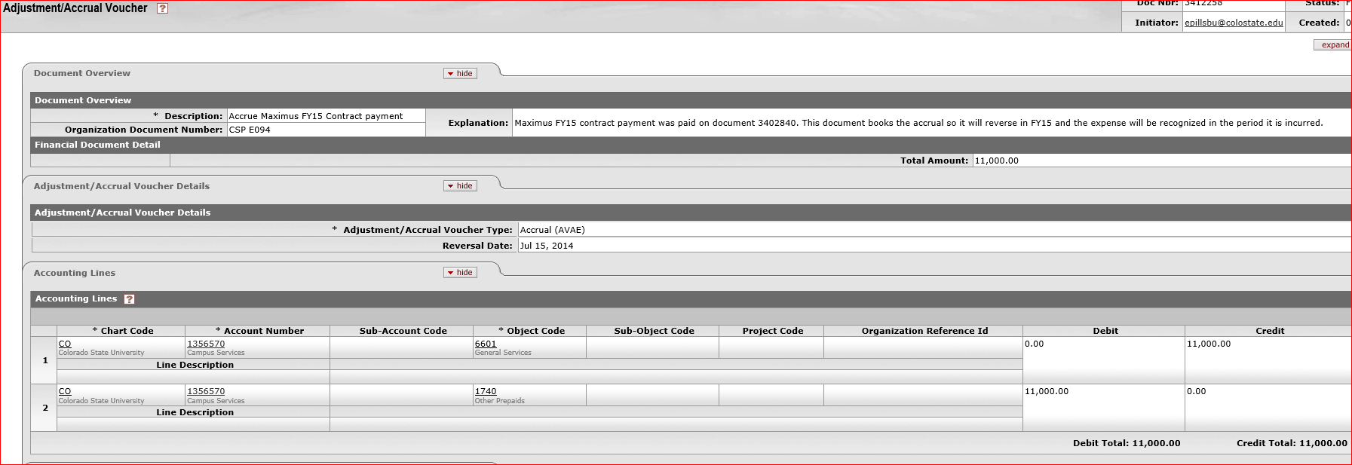
Recording prepaid (1740 object code)
Department 6003 paid for a maintenance contract in FY14, but the contract did not start until FY15. In this case, the AV document should be created to record prepaid in FY14. If the reversal date is entered the document reverses automatically on the date you want the document to be reversed. In this way you don’t have to do a manual entry to move it from prepaid to an expense object code in FY15.

Slide 14
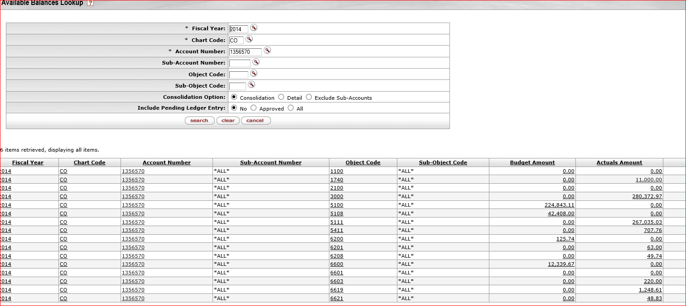
FY 14 entry after AV document is created. Object code 1740 is showing $11K balance.

Slide 15
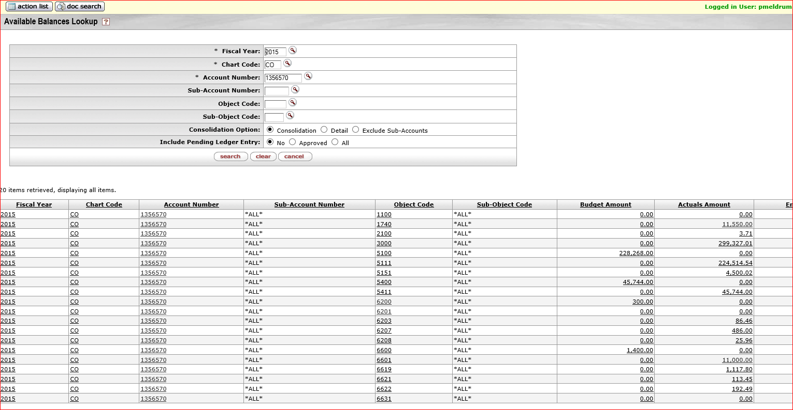
In FY15 after the AV document reverses, the balance shows in the expense object code (6601) for $11K. balance in object code 1740 technically would be zero but there is another prepaid document that was booked in May for $11,550.

Slide 16
If the maintenance services is for more than 2 years. Then we recommend to enter the Adjustment/Accrual Voucher (AV) document as an “Adjustment” and manually move the expense from Prepaid (1740) to Expense (6XXX) object code for the specific year.
Example:
The maintenance service agreement of $3,000 was purchased in FY18. Which would cover maintenance agreement for FY18, FY19, and FY20. Payment request for $3K was processed in FY18.
The entry for FY18, FY19, & FY20 would look like……..

Slide 17
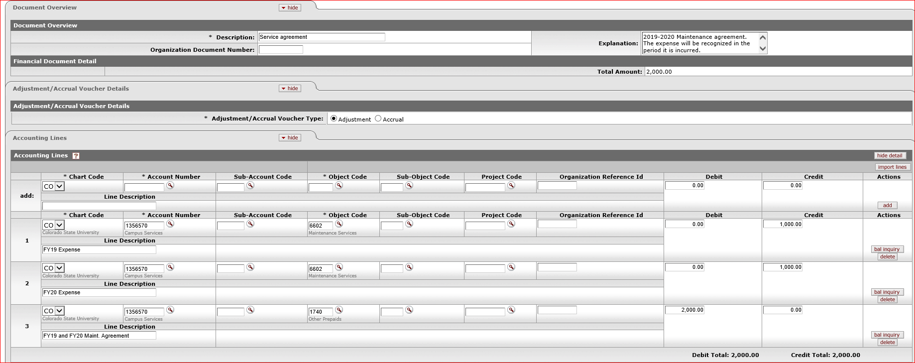
FY18 Entry
Create a AV document for $2,000. Because entire $3000 is currently recorded as an expense in 6602 (Maintenance Services).

Slide 18
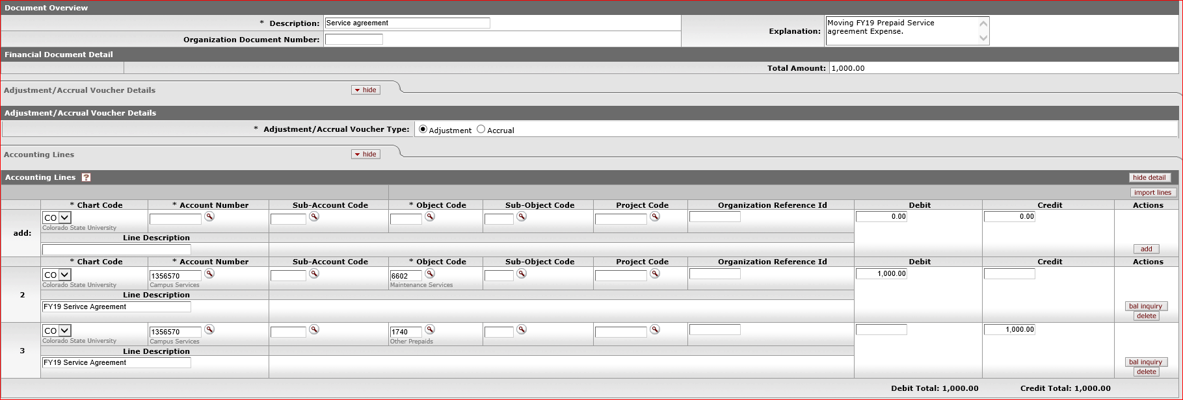
FY19 Entry
Create a AV document reversing FY19 Service agreement from Prepaid (1740) to Expense (6602) for $1,000.00

Slide 19
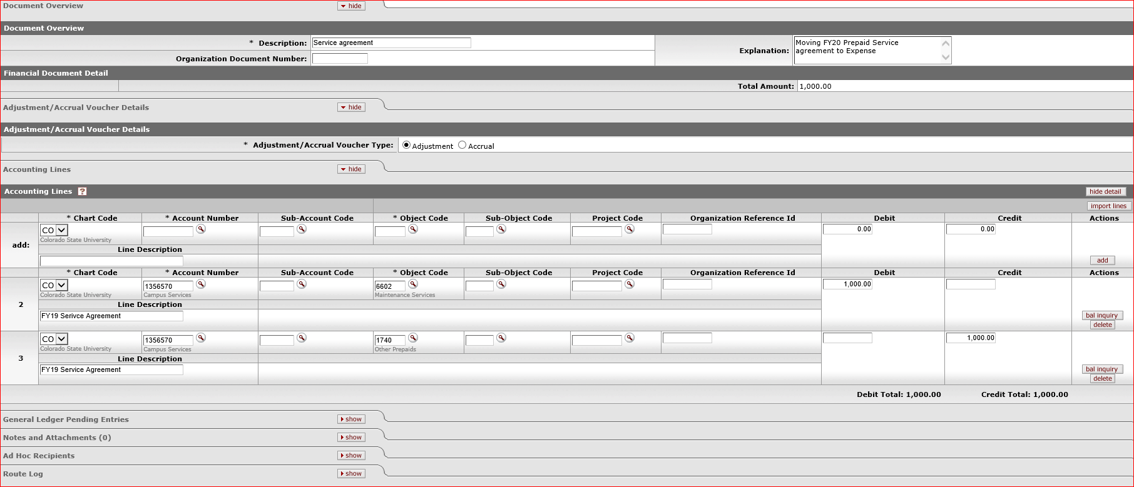
FY20 Entry
Create a AV document reversing FY20 Service agreement from Prepaid (1740) to Expense (6602) for $1,000.00. This would be the final AV document for this Service agreement.

Slide 20
Things to remember at
If the invoice is sent to A/P on June 2019, but a invoice date is for FY20 (July 2019-June 2020). A/P would automatically code it to a prepaid (1740) object code.
In this case, you have to manually move this to expense object code (6XXX) in FY20.

Slide 21
Prepaid for ghost card charges
Example: A traveler will be attending a conference in Atlanta August 8th – 12th. The department purchased the airfare using the Ghostcard on May 17th, the cost of the airfare purchased is $430.40.
In the below example: the actual expense is posted in FY17 but travel will occur in FY18, these expense should post to FY18. Therefore, an accrual document needs to be created to properly recognize the expense in FY18.

Slide 22
Booking receivable
Receivable is the money that a company has a right to receive because it had provided customers with goods and/or services.
Under accrual accounting, anytime external work is completed and goods have been delivered but there is no cash exchange, department has to book a receivable (object code:14XX) in the account.
This ensures that revenue is recorded in the correct period.
Note: We do not book receivables on internal revenue. The reasoning is we would basically be booking receivables to ourselves (thinking of CSU as a whole)

Slide 23
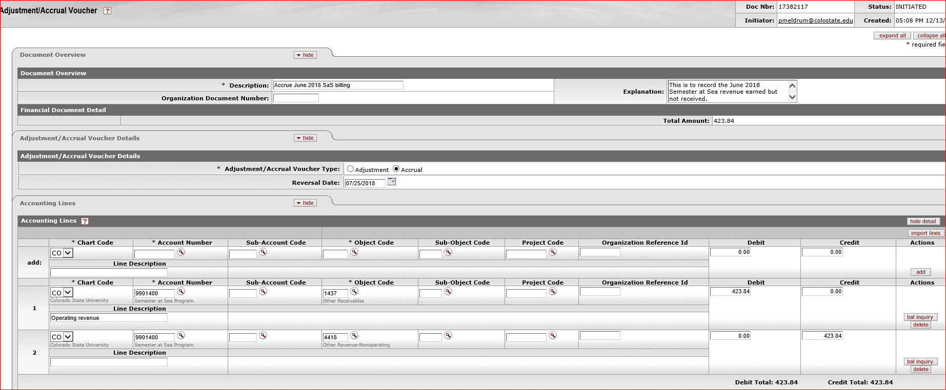
Below is the Example of booking receivable for revenue that is earned but not received:
The AV document should be created to record the revenue at the same period when service has been performed.
Dr. 14XX (receivable object code)
Cr. 4XXX (revenue object code)

Slide 24
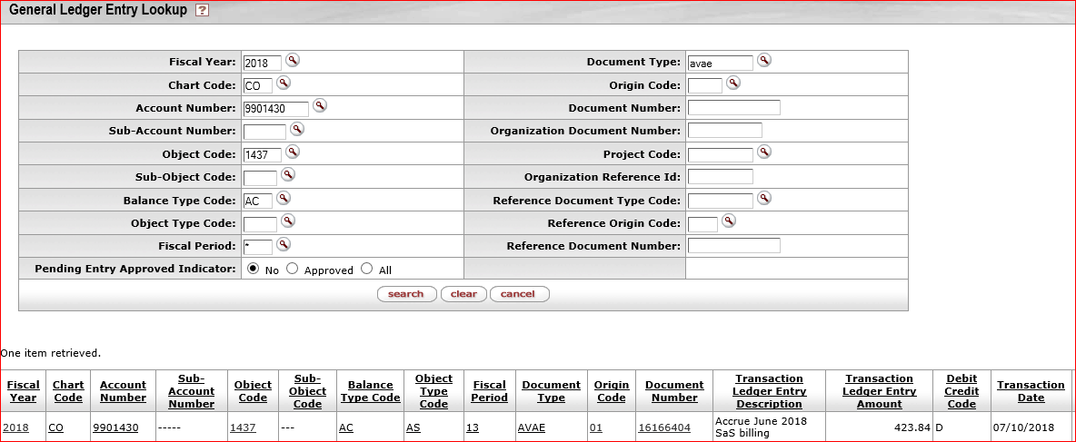
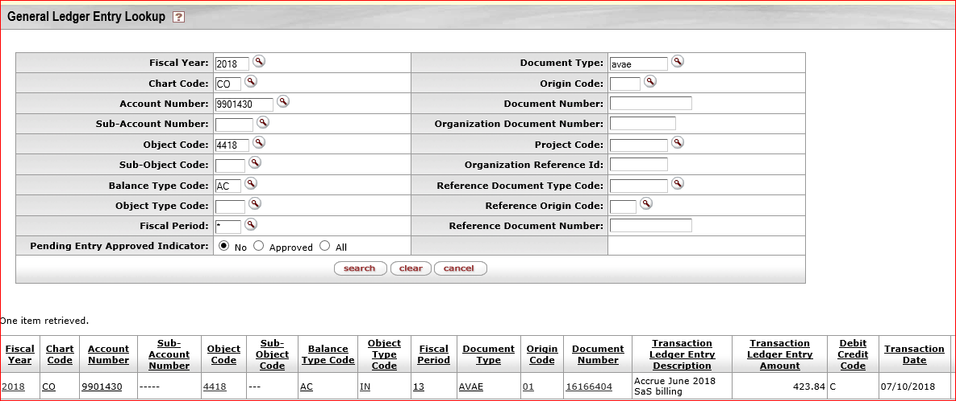
After the AV document, the General Ledger entry would look like this:
14XX Dr.
44XX Cr.
Revenue balance is always “credit”. This shows that revenue 44XX is posted in FY18.

Slide 25
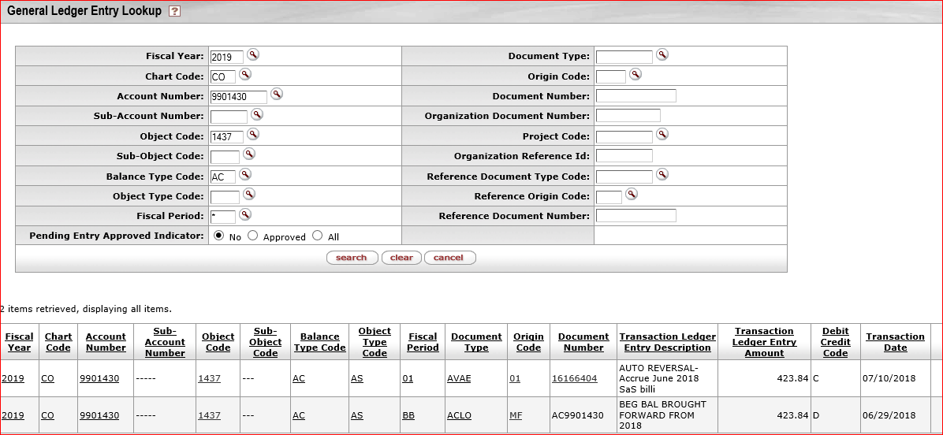
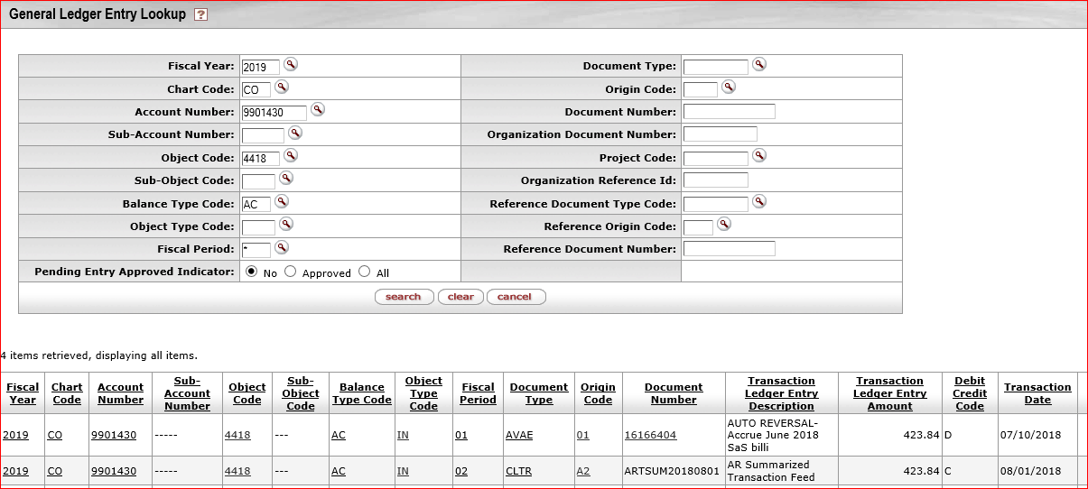
The document was set to reverse on 7/25/18. When the document is reversed on this date the entry flips and books the revenue on that specific month/year. When that happens the entry would look like:
Cr. 14XX (receivable object code)
Dr. 4XXX (revenue object code)
The Beginning balance in 14XX object code is coded as “Debit”, when the document reverses, it will be coded as “Credit”, so this washes the 14XX object code.
In FY19: when cash receipt document is deposited in 4XXX object code. That will wash the revenue booked in FY19. So, the revenue is only booked (credited) in FY18.

Slide 26
If the AV document is coded as an “Adjustment” instead of having a reversal date then…
When the payment is received, cash receipt (CR) document should be deposited in 14XX object code as a negative receivable
What if the CR is deposited into 4XXX object code instead of 14XX object code?
Therefore it’s important, that you review these object codes when reconciling the account.
Then GEC needs to take place to clear the 14XX object code. Support should show the CR /AV document showing where the payment was posted.
Balances in balance sheet object code like 14XX & 2XXX, will continue to carryforward each year.

Slide 27
Accruing Liabilities
Accrued liabilities are liabilities that reflect expenses that have not yet been paid during an accounting period; in other words, a company's obligation to pay for goods and services that have been provided for which invoices have not yet been paid.
Department has to book these liabilities under object code: 2XXX in the correct period.

Slide 28
Below is an example of rent expense that was incurred in one period but paid in the next period
To ensure expense is recorded in a correct period, AV document is created and reversed in the period when the payment is made.

Slide 29
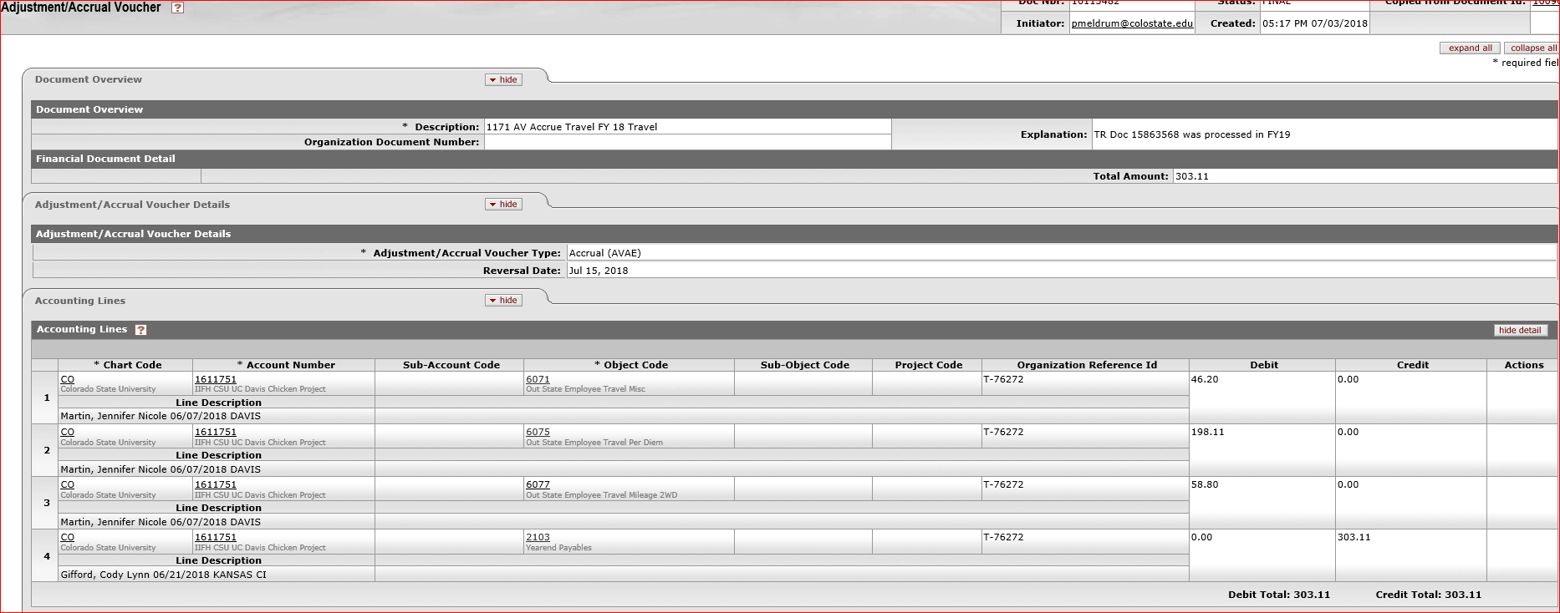
Travel document accrual
Accrual document needs to be submitted for all travels that occurs in FY19 but reimbursement will not be processed until FY20.
For these travel accruals, your entry would look like below:

Slide 30
Other Accruals (Liabilities) Unearned revenue
Unearned revenue is money received by an individual or company for a service or product that has yet to be fulfilled. In other words; Revenue received in FY18, but earned in FY19
Examples:
Sports/Youth camps paid in advance for next fiscal year
Tuition paid in June for summer semester ending in August
Football season tickets sold in June, 2018 but the game is in the future months/years.
Soil Testing complete, but revenue not received by June 30th
Entry would look like:
Dr. 4XXX (Revenue object code)
Cr. 2590 (Unearned Revenue)

Slide 31
Accrual consideration at fiscal year end:
Verify outstanding Purchase Orders to identify which one is for FY19 and FY20.
If items are received in FY19 but paid after year-end, these should be accrued in FY19. Please review Disbursement Vouchers issued after year-end to ensure expenses are accrued in the correct period.
TR created after June 30th for June 30th or prior travel should be accrued by the department.

Slide 32
Questions?

Slide 33
Campus Services
Summer Leaming 491-2801 Publina Meldrum 491-4148
http://busfin.colostate.edu/Depts/Campus_Svcs.aspx

